Slide 1


Time Series Forecasting
Argentina Oil and Gas Production Prediction
using SARIMAX model
Source Data: Secretaría de Energía de la Nación Argentina

Slide 2

Time series has a difficult forecasting approach but not impossible
We are going to use Source Data from Argentina Oil and Gas Production
Period: Jan-2009 to Jul-2022

Slide 3
Time Series Models
Auto Regressive (AR)
Moving Average (MA)
Auto Regressive Moving Average (ARMA)
Auto Regressive Integrated Moving Average (ARIMA)
Seasoned Auto Regressive Integrated Moving Average (SARIMA)
Seasoned Auto Regressive Integrated Moving Average with Exogenous Factors (SARIMAX)

Slide 4

Auto Regressive Models
Representation of a type of random process
Specifies that the output variable depends linearly on its own previous values and on a stochastic term
The model is in the form of a stochastic difference equation
The notation AR(p) indicates an autoregressive model of order p. The AR(p) model is defined as:
$X_{t}=\sum_{i=1}^{p}{φ_{i}X_{t−i}+ε_{t}}$
where $φ_{i}$ are the parameters of the model and $ε_{t}$is white noise

Slide 5

Moving Average Models
Model univariate time series
Specifies that the output variable is Cross-Correlated with a non-identical to itself random-variable
The notation MA(q) indicates a moving average model of order p:
$X_{t}=\sum_{i=1}^{p}{θ_{i}ε_{t−i}+ε_{t}}$
where $θ_{i}$ are the parameters of the model and $ε_{t}$is white noise
Conceptually is a linear regression of the current value of the series against current and previous white noise error terms

Slide 6

Auto Regressive Moving Average (ARMA)
Describes (weakly) stationary stochastic process
Combination of AR and MA models
The notation ARMA(p, q) indicates a model with p autoregressive terms and q moving-average terms:
$X_{t}=\sum_{i=1}^{p}{φ_{i}X_{t−i}+}\sum_{i=1}^{p}{θ_{i}ε_{t−i}+ε_{t}}$
Where $θ_{i},φ_{i}$ are the parameters of the model and $ε_{t}$is white noise

Slide 7
Auto Regressive Integrated Moving Average (ARIMA)
Combination of AR and MA models
Applied when data show evidence of non-stationary where an initial differencing step can be applied one or more times to eliminate the non-stationary of the mean function, aka trend. These is the ‘I’ Part
The notation ARIMA(p, d, q) indicates a model with p autoregressive terms, d degrees of differencing and q moving-average terms

Slide 8
Seasoned Auto Regressive Integrated Moving Average (SARIMA)
Same as ARIMA with seasonal component
The notation SARIMA(p, d, q) x (P, D, Q) indicates a model with p autoregressive terms, d degrees of differencing and q moving-average terms and the uppercase PDQ refers to the autoregressive, differencing and moving average terms of the seasonal part
Seasoned Auto Regressive Integrated Moving Average with exogenous factors (SARIMAX)
Same as SARIMA but updated.
Can deal with external effects

Slide 9
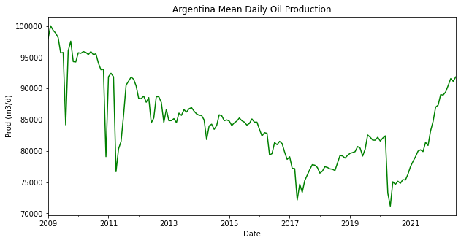
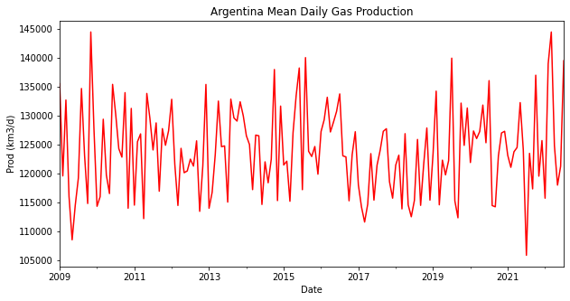
Production Time Series
 | TotalPet(m3/d) | TotalGas(km3/d)
count | 163 | 163
mean | 84443.91 | 123918.35
std | 6495.75 | 7495.47
min | 71163.54 | 105860.82
25% | 79468.45 | 117651.24
50% | 84406.51 | 123464.28
75% | 88486.06 | 128298.84
max | 100044.07 | 144420.97

Slide 10
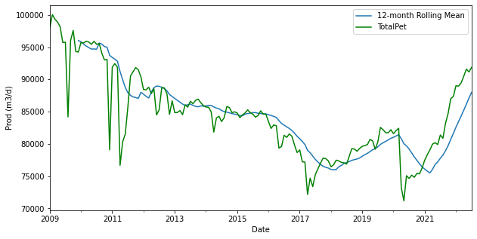
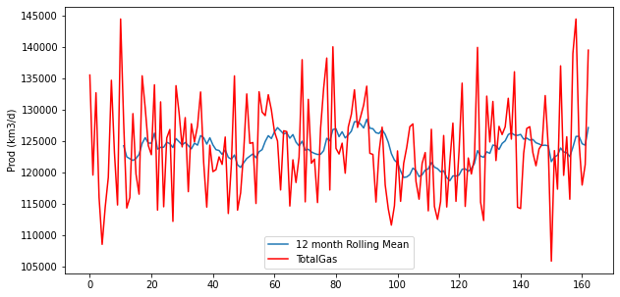
Production Time Series 12-month Rolling Mean

Slide 11
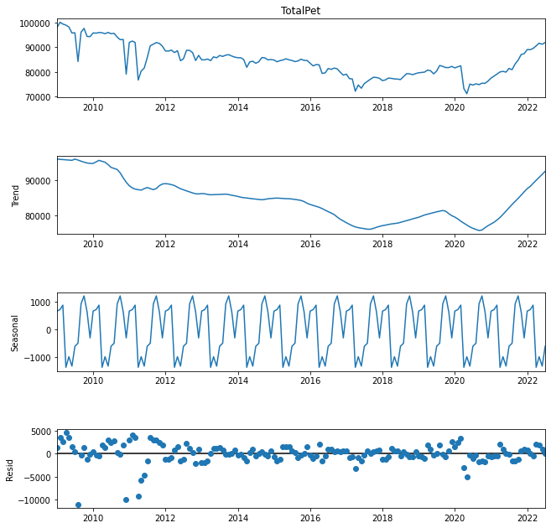
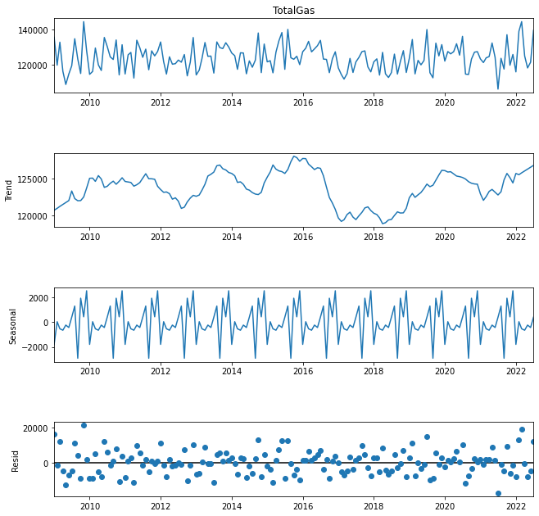
Production Time Series Seasonal Decompose

Slide 12
Checking Stationary Data Series
Dick-Fuller Statistical Test
Data is not stationary -- > Null Hypothesis (H0)
If p-value < 0.05 then H0 is rejected
For Oil Production
p-value = 0.1692 → H0 is not rejected
Differencing one month, p-value = 1.292e-18 < 0.05 --> Stationary Data
For Gas Production
p-value = 9.94e-24 < 0.05 --> Stationary Data
No differencing calculation needed

Slide 13
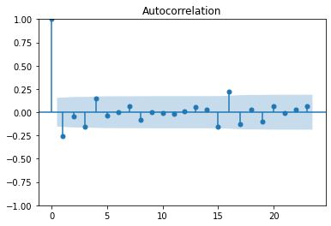
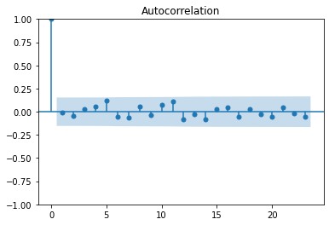
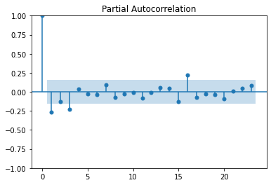
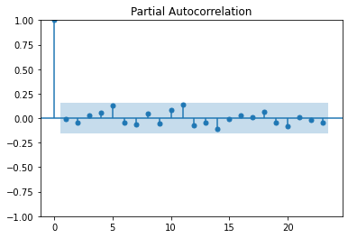
ACF and PCF Visualization
Oil
Gas

Slide 14
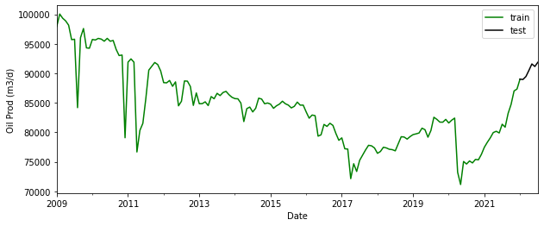
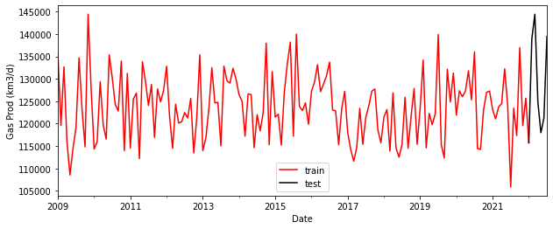
Training Models
Train Set: Jan-2009 to Jan-2022 Test Set: Jan-2022 to Jul-2022
Last 7 months
4,5 % of Data is used to test

Slide 15
Models Results
Gas
Model: ((0, 0, 2), (1, 2, 2, 12))
Min AIC: 2287.58
Oil
Model: ((2, 1, 0), (2, 2, 1, 12))
Min AIC: 1929.07
 | coef | std err | z | P>|z| | [0.025 | 0.975]
ar.L1 | -0.1022 | 0.095 | -1.081 | 0.280 | -0.287 | 0.083
ar.L2 | -0.0307 | 0.084 | -0.364 | 0.716 | -0.196 | 0.135
ar.S.L12 | -0.2662 | 0.167 | -1.597 | 0.110 | -0.593 | 0.061
ar.S.L24 | -0.2186 | 0.090 | -2.438 | 0.015 | -0.394 | -0.043
ma.S.L12 | -1.1773 | 0.246 | -4.786 | 0.000 | -1.659 | -0.695
ma.S.L24 | 0.1468 | 0.177 | 0.831 | 0.406 | -0.199 | 0.493
sigma2 | 3.912e+06 | 1.05e-07 | 3.72e+13 | 0.000 | 3.91e+06 | 3.91e+06
 | coef | std err | z | P>|z| | [0.025 | 0.975]
ma.L1 | 0.1214 | 0.241 | 0.504 | 0.614 | -0.350 | 0.593
ma.L2 | 0.0274 | 0.252 | 0.109 | 0.913 | -0.466 | 0.520
ar.S.L12 | -0.3687 | 0.307 | -1.201 | 0.230 | -0.971 | 0.233
ma.S.L12 | -0.6111 | 0.235 | -2.595 | 0.009 | -1.073 | -0.150
ma.S.L24 | 0.1505 | 0.177 | 0.852 | 0.394 | -0.196 | 0.497
sigma2 | 3.143e+08 | 3.5e-10 | 8.97e+17 | 0.000 | 3.14e+08 | 3.14e+08

Slide 16
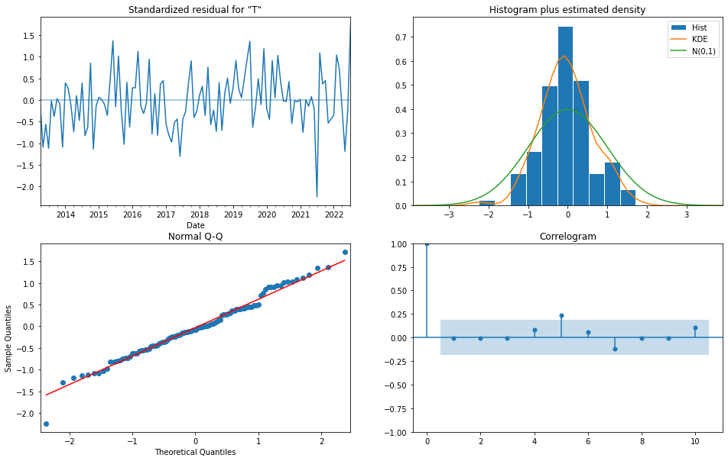
Gas Model Diagnostic Plots

Slide 17
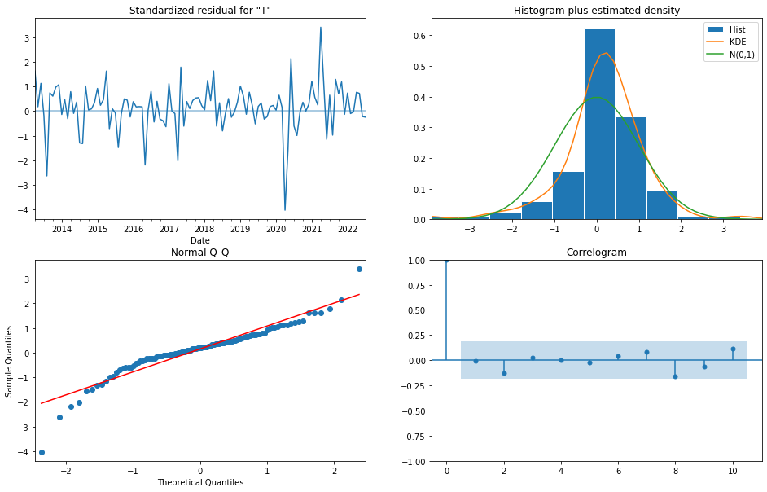
Oil Model Diagnostic Plots

Slide 18
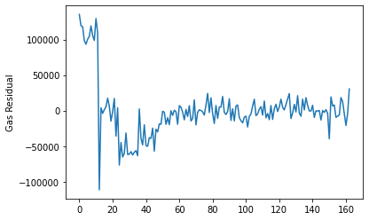
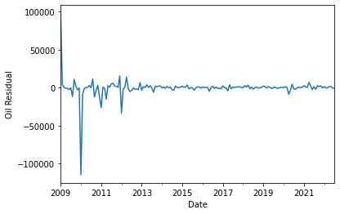
Models Residuals Plot
Less residual variance in Oil than Gas

Slide 19
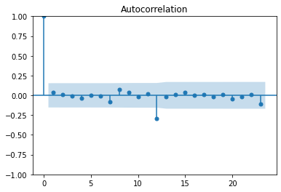
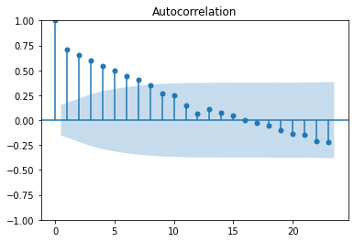
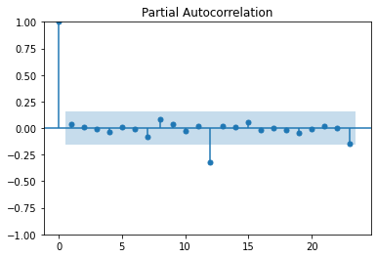
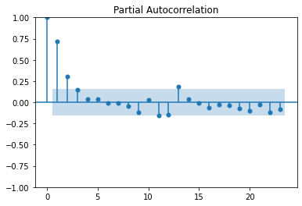
Models ACF and PACF Visualization
Oil
Gas

Slide 20
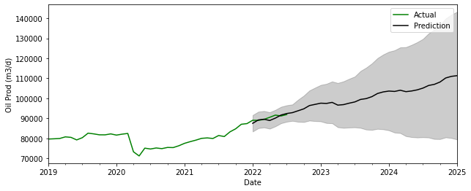
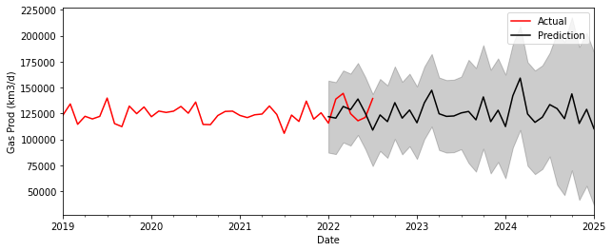
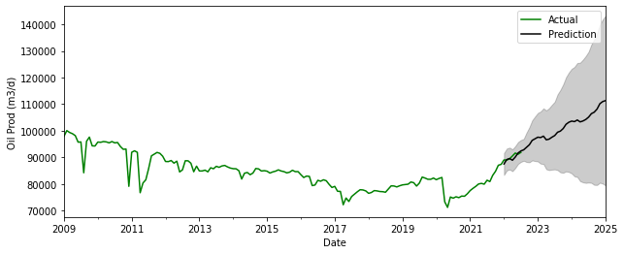
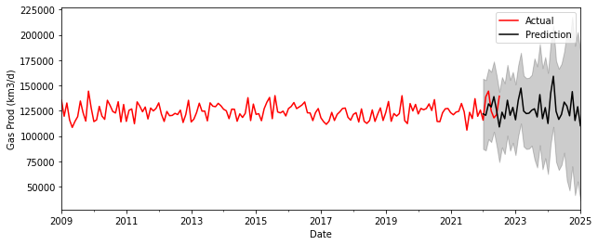
Models Predictions
As we move forward in predicted time, confidence intervals start to diverge

Slide 21
What happens if we change Data Units?

Slide 22
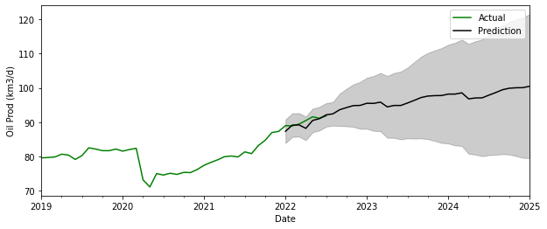
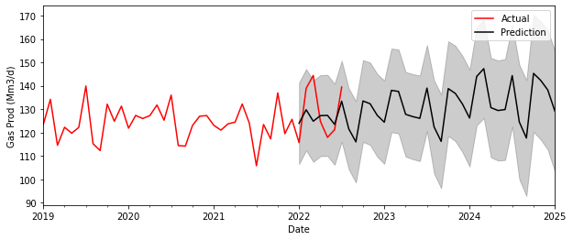
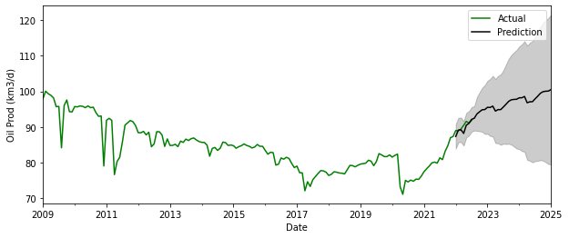
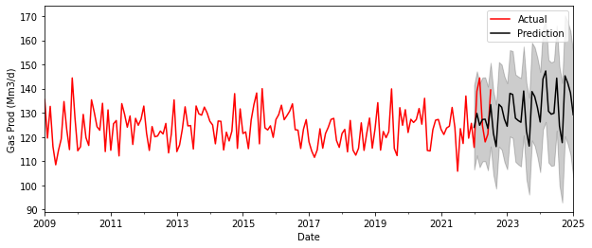
Models Predictions
Gas in Mm3/d and Oil in km3/d, as we can see Forecasting changes

Slide 23
Models Summary
Data | SARIMAX Model | AIC | RMSE | % RMSE / mean
Total Gas (km3/d) | ((0, 0, 2), (1, 2, 2, 12)) | 2287 | 16645 | 13,43
Total Gas (Mm3/d) | ((0, 2, 2), (0, 2, 2, 12)) | 773 | 9.79 | 7.90
Total Pet (m3/d) | ((2, 1, 0), (2, 2, 1, 12)) | 1929 | 1047.88 | 1.24
Total Pet (km3/d) | ((2, 1, 2), (2, 1, 2, 12)) | 463 | 1.15 | 1.35

